Slide 1
3V3
GND
TX
RX
LEDs
LEDs
LED_Top/In
LED_Cam
Reed
NC
OpiTX
OpiRX
OpiGND
Relay -
SDA
SCL
GND
VCC
1K
Relay
VBUS | 5V
GND | GND
16 | LED_Top/In
18 | LED_Cam
33 | Reed
35 | Switch_D
37 | OpiTX
39 | OpiRX
3V3 | VCC
12 | SDA
11 | SCL
9 | Switch_U
7 | PWR
5 | RX
3 | TX
EN | NC

Slide 2
5V
GND
LED_Top
Reed
Relay +
PiGND
Power
Relay -
5 | Touch_1
6 | Touch_2
7 | N/C
8 | Reserved
9 | Reserved
10 | Reed
20 | RX
21 | TX
1K
VBUS | 5V
GND | GND
3V3 | VCC
4 | LED_Top
3 | N/C
2 | Reserved
1 | LED_Cam
0 | PWM
OpiTX
OpiRX
LED_Cam
PWM

Slide 3
GND
Power
Relay -
Relay +
Reed
LED_Top
Pi/GND
5V
5 | Buzzer
6 | LED_Cam
7 | PWM
8 | Reserved
9 | Reserved
10 | Power
20 | RX
21 | TX
1K
100K
VBUS | 5V
GND | GND
3V3 | VCC
4 | LED_Top
3 | Reed
2 | Reserved
1 | Touch_2
0 | Touch_1
PWM
LED_Cam
Buzzer
OpiRX
OpiTX

Slide 4
LED_Cam
PWM
100K
Buzzer
OpiTX
OpiRX
1K
5 | N/C
6 | LED_Cam
7 | PWM
8 | Reserved
9 | Reserved
10 | Buzzer
20 | RX
21 | TX
VBUS | 5V
GND | GND
3V3 | VCC
4 | LED_Top
3 | Reed
2 | Reserved
1 | Touch
0 | Power

Slide 5

VCC
Reed
Light
GND

Slide 6
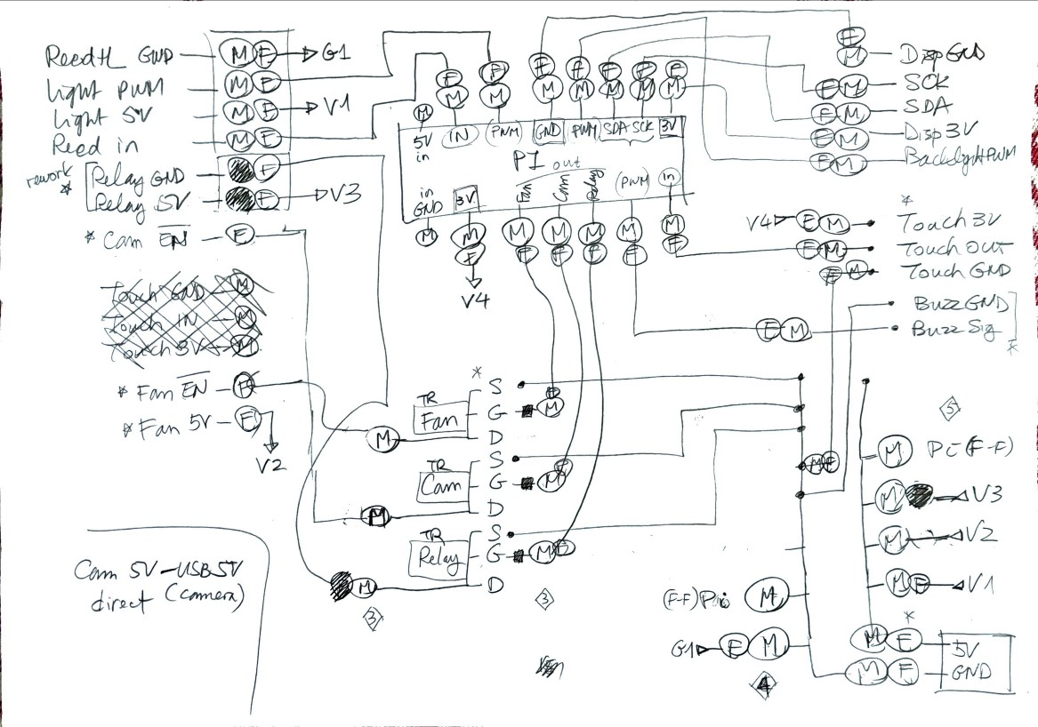

Slide 7
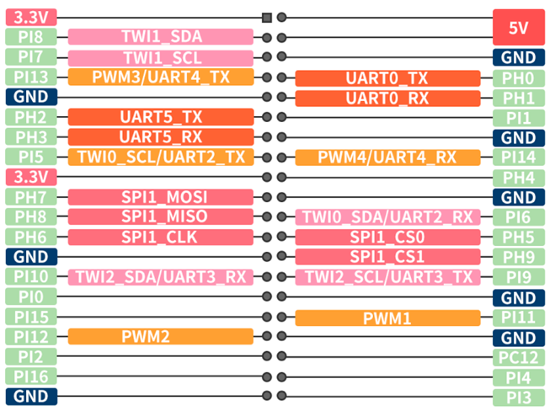
Light 5V |  | 5V in | Pi 5V | Relay | Fan
Light D |  |  |  | RelayD | FanD | CamD
Reed in | → | Reed in | Light G | RelayG | FanG | CamG | Buzzer
GND |  | GND in | Pi GND | RelayS | FanS | CamS | Buzzer
Disp 3V
Disp SDA
Disp SCK
Disp PWM
Disp GND
Touch 3V
5V in
GND in
Light
Reed
Touch in
Touch GND
Buzzer PWM
Cam
Fan
Relay

Slide 8
Male
Female
1K
10K
1K
10K
10K
1K
1K
10K

Slide 9
ToPv3 actual
Relay
CPU
1K
1K
1K
Cooler
10K
Box
10K

Slide 10
ToPv3 enhanced
Relay
CPU
1K
1K
1K
1K
Cooler
10K
10K
Box
10K

Slide 11
1K

